Slide 1

Password Encryption and Storage System

Slide 2
Group members
Name | Roll Number | PRN
Aarya Tiwari | 3 | 12010588
Harshal Abak | 5 | 12011089
Abu Ansari | 9 | 12010599
Kaivalya Aole | 26 | 12011359
Guide: Prof. Amol Bhillare

Slide 3
Introduction
Increasing popularity of e-commerce and rapid growth of internet technology.
Data encryption plays a very important role in data security.
Can’t keep easy passwords.
Remembering lengthy passwords is not easy.

Slide 4
Problem Statement
Make a secured password encryption and storage system.

Slide 5
Data Structures used
Arrays
HashMap
StringBuilder

Slide 6
Literature Survey
Title | Publication Year | Author Name | Summary
A Complex Encryption System Design Implemented by AES | December 2021 | Zhimao Lu, Houmed Mohamed | The authors of this paper described the methodology followed by the Advanced Encryption Standard Algorithm and how the passwords are encrypted using AES and made different comparisons between AES, RSA and Key management factors.
TOWARDS A DEEPER NTRU ANALYSIS: A MULTI MODAL ANALYSIS | June 2020 | Chuck Easttom, Anas Ibrahim | This paper described and discussed various applications of encryption in the cryptography field. It had nothing much to do with password encryption but it gave a pretty concrete idea how encryption works and how secure is it and different kinds of cyber attacks.

Slide 7
Methodology
Take entries from the user, store them in objects locally.
Encrypt the password with suitable algorithms.
Store the username, encrypted password and salt value in a suitable database using jdbc.
When user requests to access the password, decrypt the password and show it to the user.

Slide 8
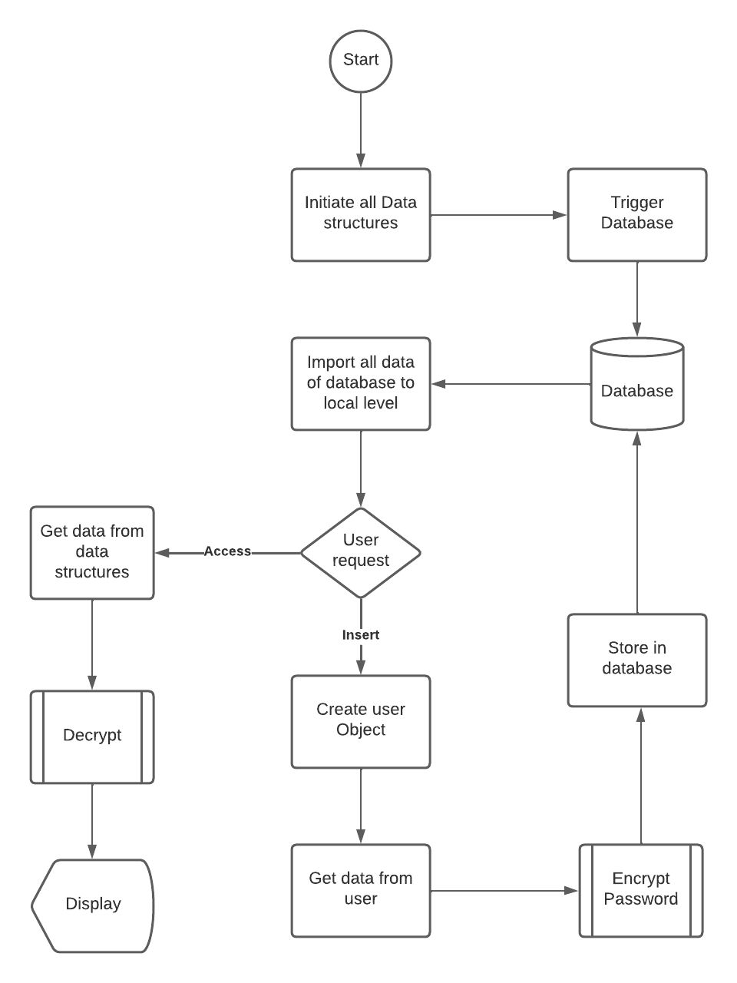
Flow Chart

Slide 9
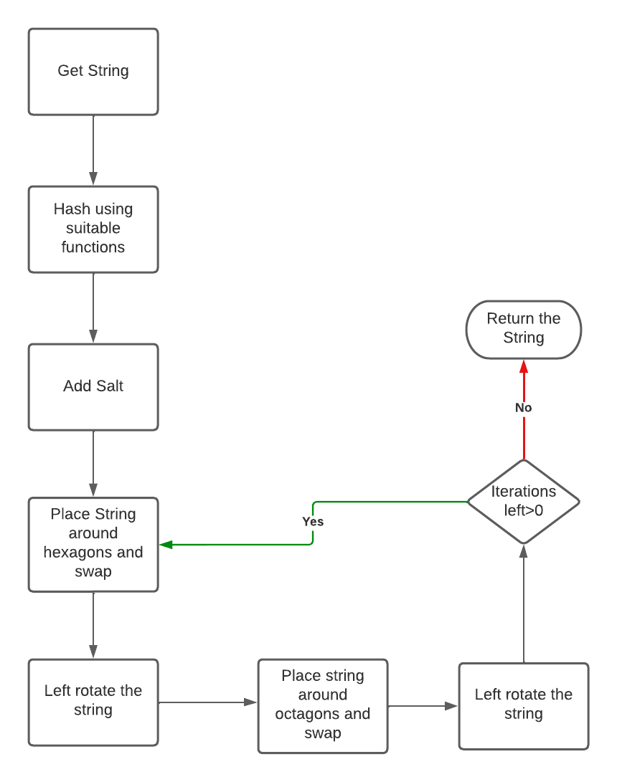
Encryption algo Flow Chart

Slide 10
How the encryption works
P@S$w0rD1234
)@=$[z>Drkbe

Slide 11
How the encryption works
P@S$w0rD1234
)@=$[z>Drkbe
Fds%$#hr$%34j7

Slide 12
How the encryption works
P
@
0
S
w
$

Slide 13
How the encryption works
P
@
0
S
w
$

Slide 14
How the encryption works
P
@
0
S
w
$

Slide 15
How the encryption works
$
w
S
0
@
P

Slide 16
How the encryption works
$
w
r
D
S
0
4
1
@
P
3
2

Slide 17
How the encryption works
$
w
r
D
S
0
4
1
@
P
3
2

Slide 18
How the encryption works
$
w
2
3
S
0
1
4
@
P
D
r

Slide 19
How the encryption works
1
$
S
2
@
w
D
3
P
0
r
4

Slide 20
Results
Input String: P@S$w0rD1234
Output after 1 cycle: 1$w0P@S234rD
More the cycles, more complicated the output gets.
For decryption, we just reverse the process.

Slide 21
Scope
You can store passwords securely.
No data leakage problem.
Even if data is stolen, it won’t be readable.

Slide 22
THANKS!!
Any Suggestions?

